Slide 1

Notes:
Hi. My name is John and welcome to the CMP Training Workshop

Slide 2
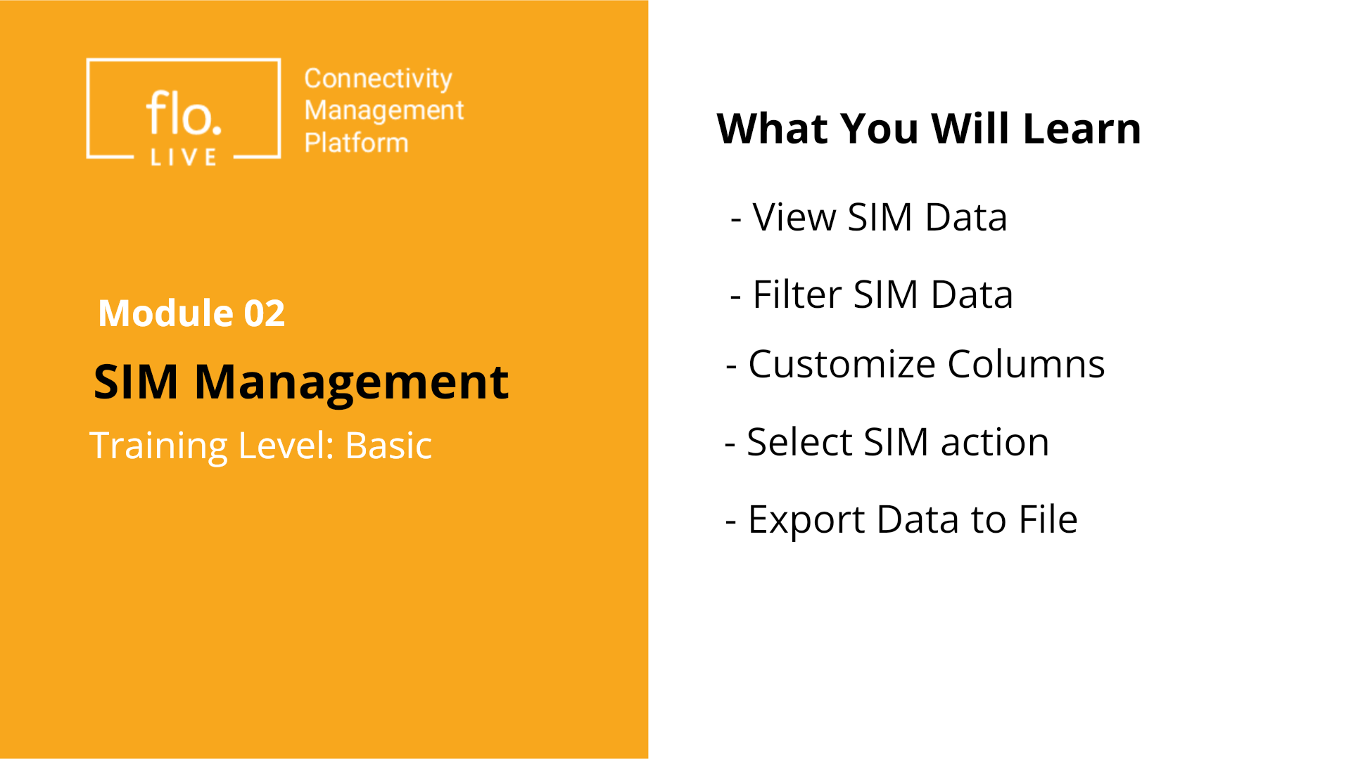
Notes:
In this video, you will learn how to access and view your SIM data. Next, we will explore how to filter the data and customize the table columns. . Then we will review the types of actions you can perform on your SIM data and finally, we will learn how to export data from the SIM table to an external file.

Slide 3

Notes:
We'll begin by taking a brief look at the information displayed in the SIM Data Table

Slide 4
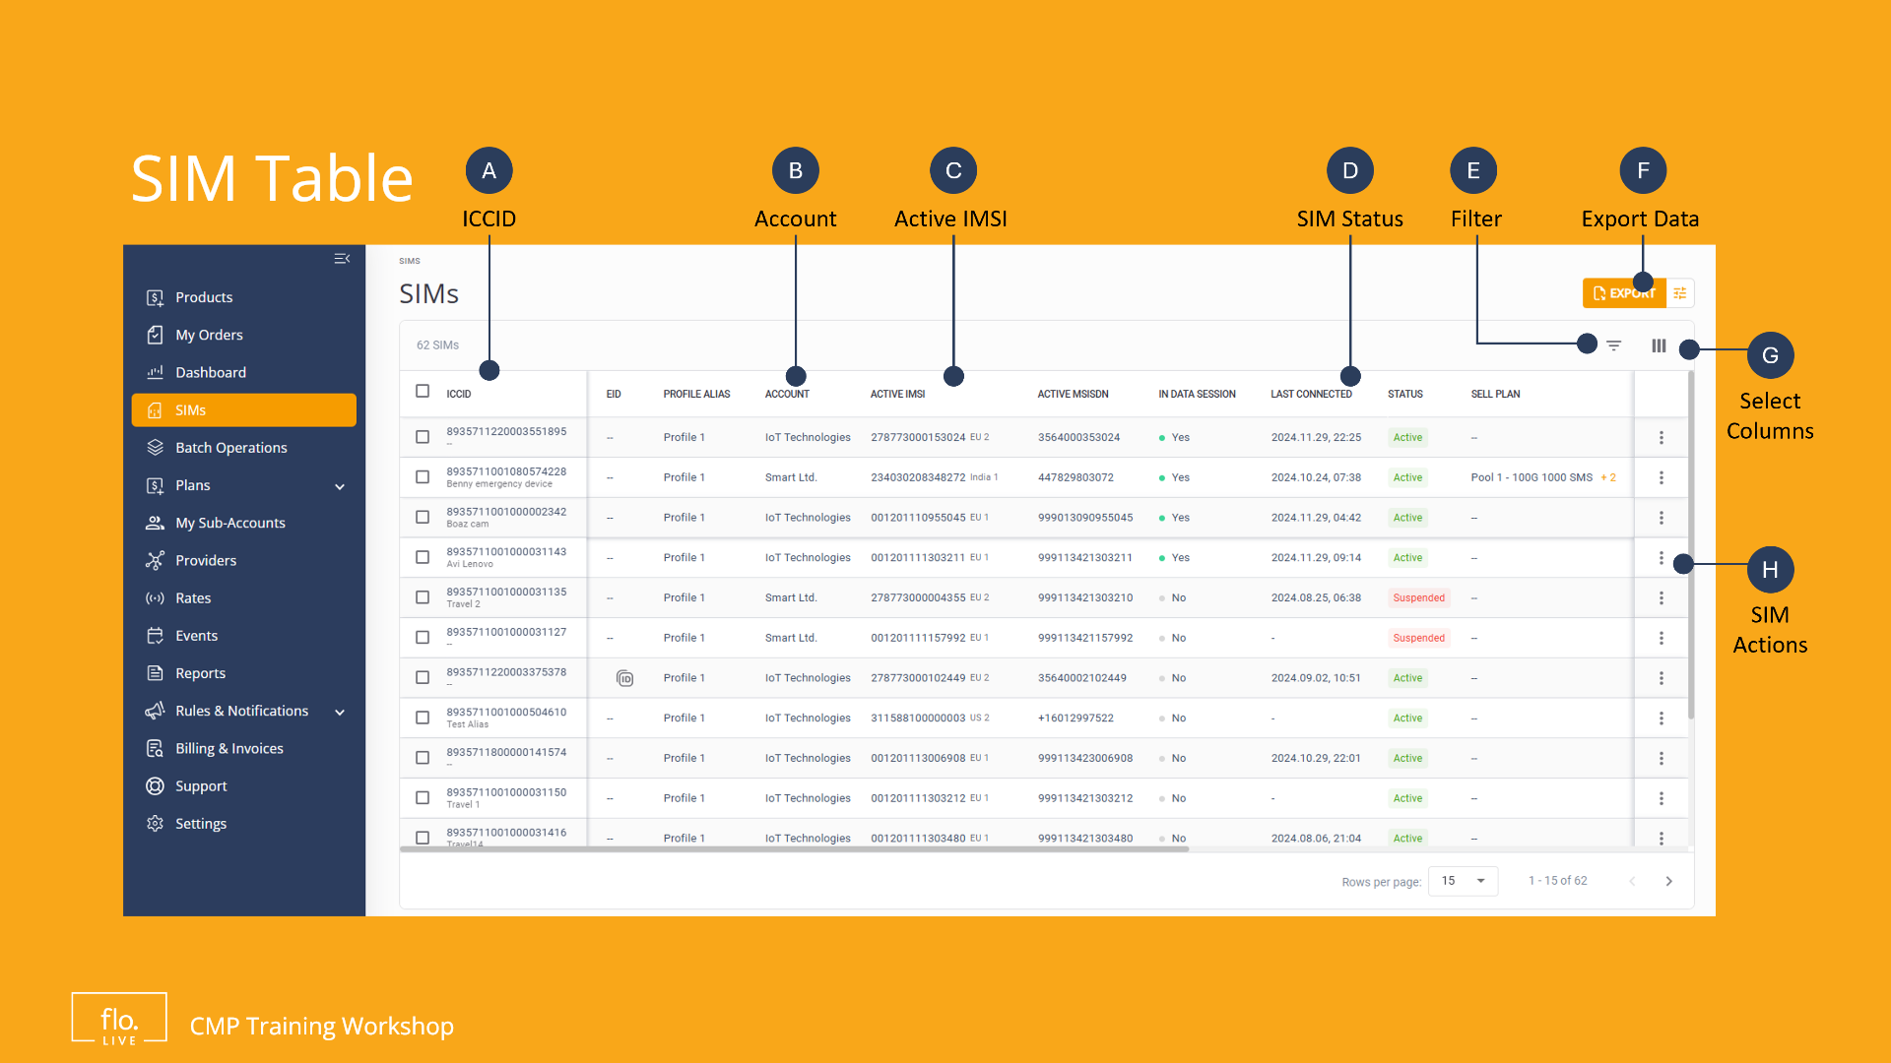
Notes:
The SIMs table lists the SIMs that have been allocated to the current account and sub-accounts. Each SIM is displayed in a separate row, The columns display the SIM attributes and operational status,

Slide 5

Notes:
Lets explore how to view your data in the SIM table.

Slide 6
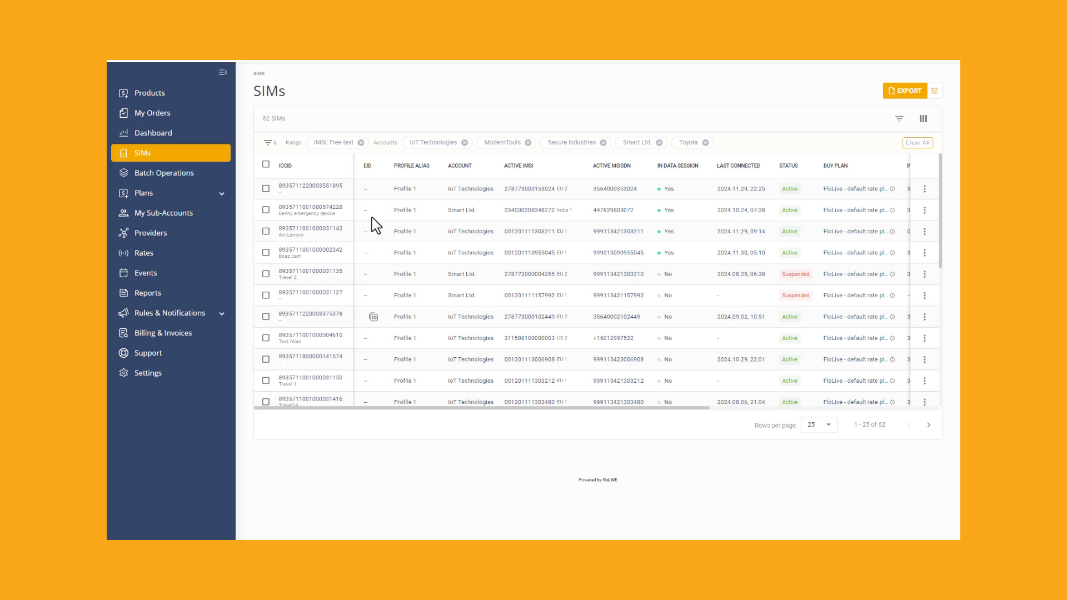
Notes:
Navigate to the sidebar and click the SIMs menu item. Remember, each SIM is displayed on a separate row. You can scroll the page to view all your SIMS, or set the number of SIMs to be displayed in the table. . This feature is particularly useful when you have a large number of SIMs. Now lets take a look at the table columns. Notice how each of the columns is revealed when you scroll the table horizontally. . To drill-down and display the details of a specific SIM, simply double-click on a row to display the SIM Info page. Lets go back to the SIM table.

Slide 7

Notes:
Now that you know how to use the SIM table, you can filter the data to display relevant information.

Slide 8
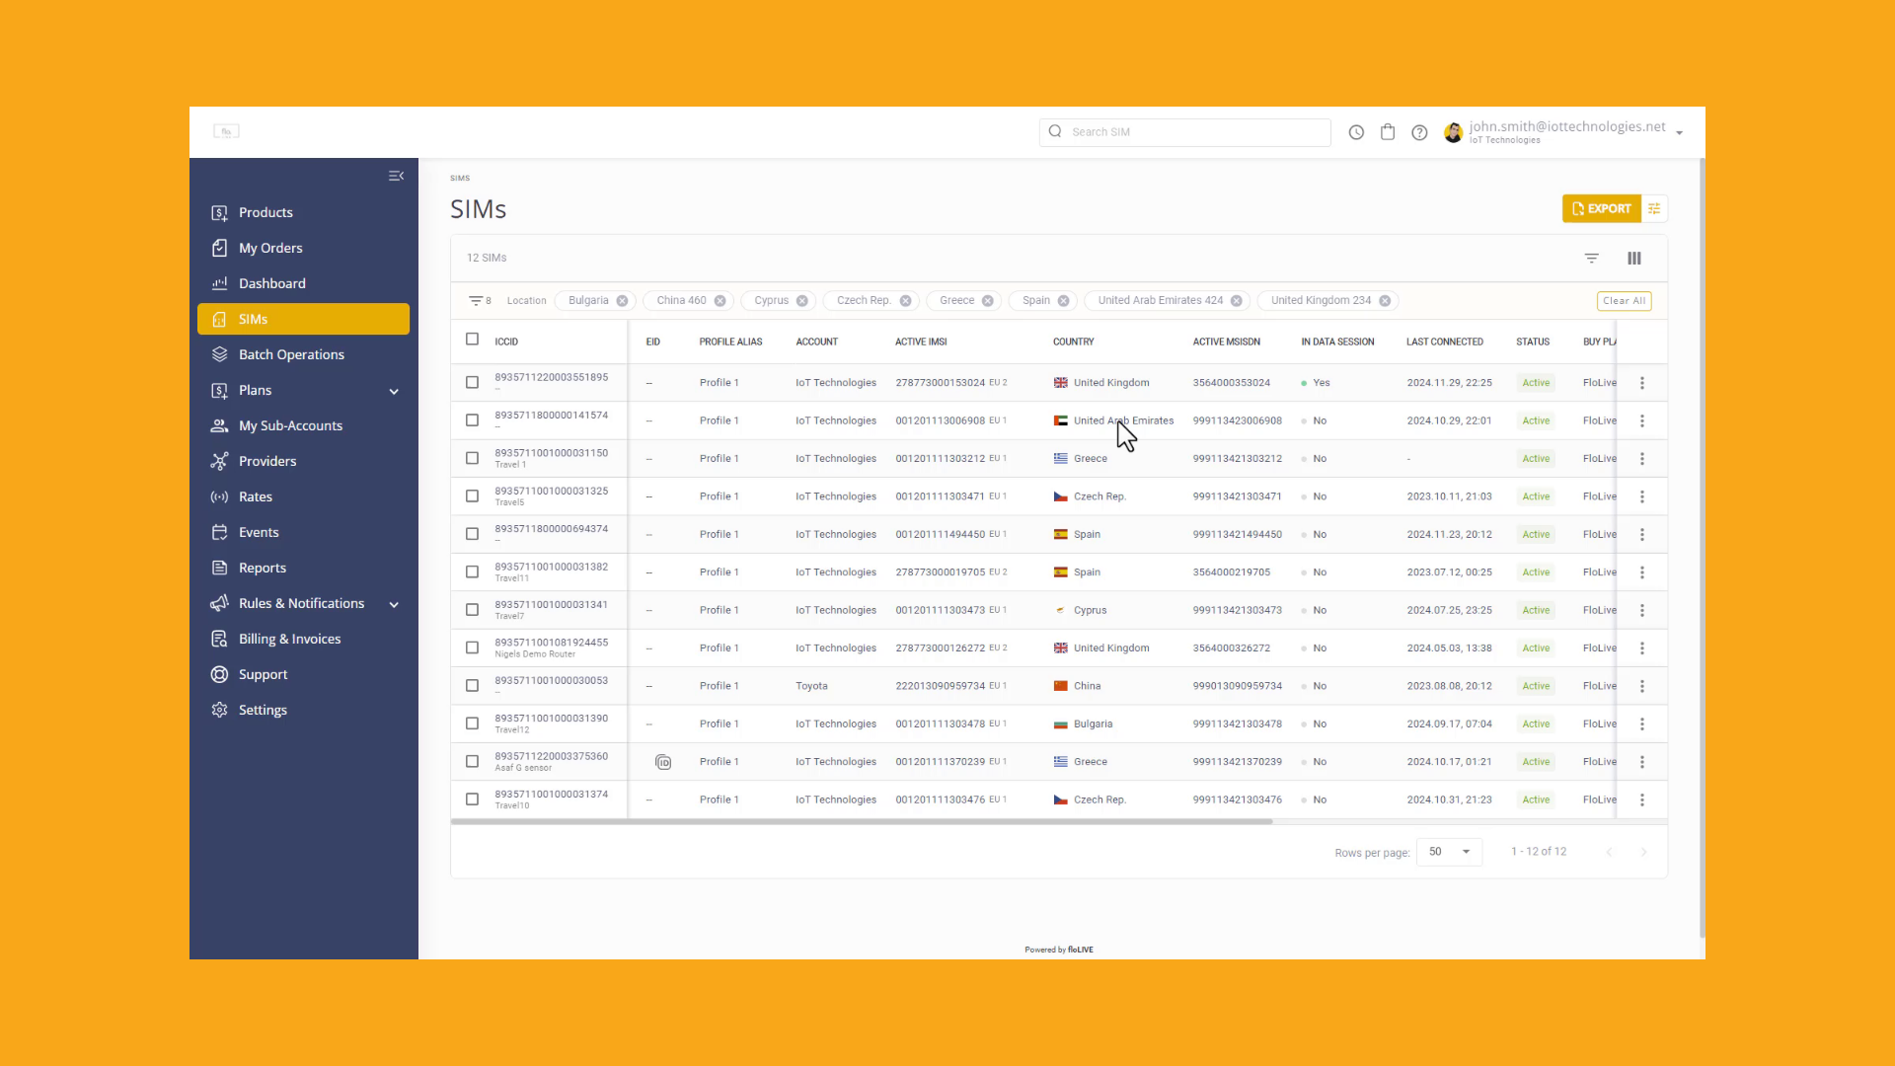
Notes:
To populate the SIM table with specific criteria, click the Filter icon at the top of the page. Scroll thru each of the filter criteria and make your selection. There are dozens of options to choose from, so we encourage you to learn more about the filtering criteria in our technical documentation. For example, Lets say we want to display only SIMs that are active in the United States. You can navigate to the Location panel and select "United States". When you click Apply, the SIM table displays information about SIMs located in the United States.

Slide 9

Notes:
Now I will show you how to customize the table columns.

Slide 10
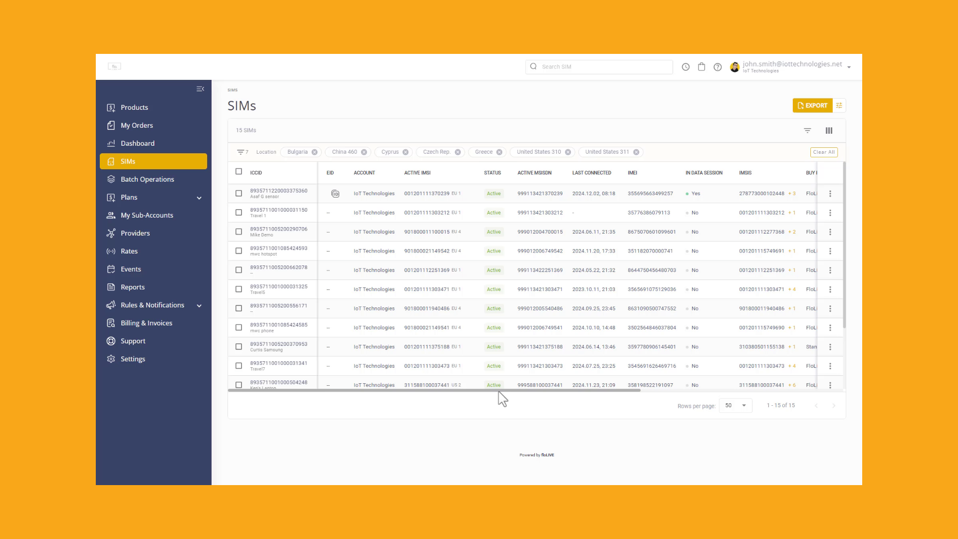
Notes:
The SIM table may contain many columns, and sometimes youmay need to scroll left and right to find the information you are looking for. . You can select the order of the colums to create a more convenient user experience. Simply Drag & Drop each of the columns and place them in the order you want. Click Save to update the SIM table with your new layout.

Slide 11

Notes:
Lets explore the types of actions you can perform on your SIMs.

Slide 12
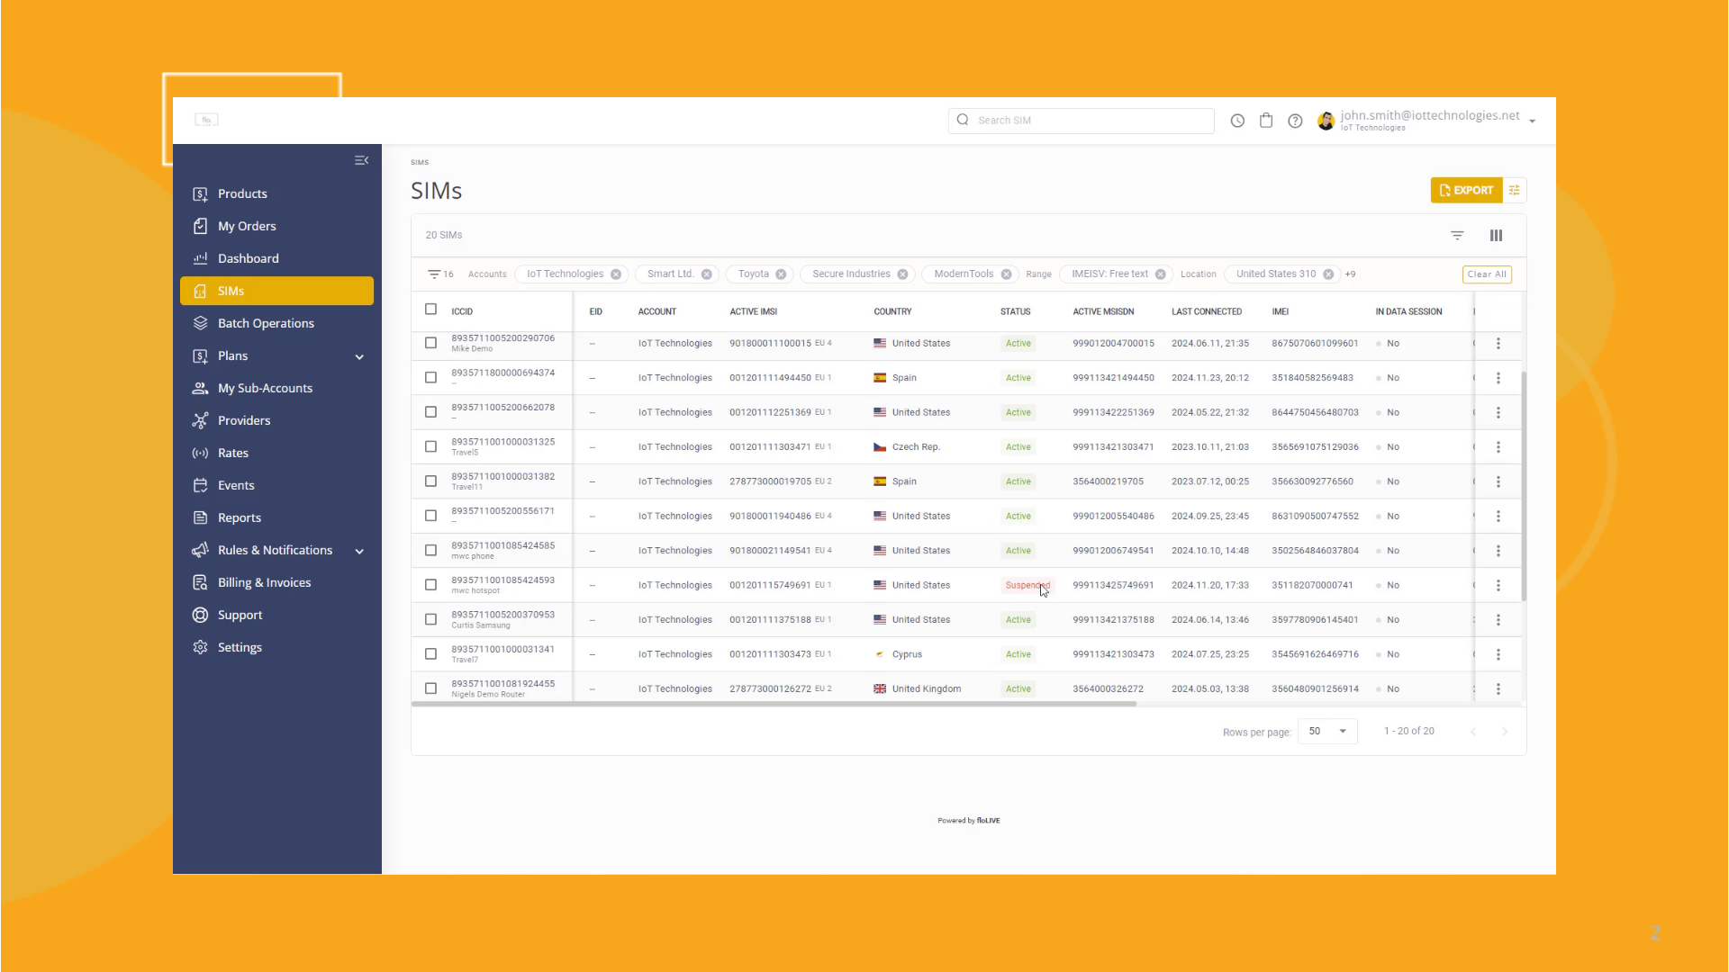
Notes:
When you click the Actions icon for a row in the SIMs table, you can select one of these options. Click Suspend to deactivate the SIM, move it to another account, assign an alias or label your SIMs for easier searches, , send a text message to the device, reload the SIM to resolve connectivity issues and lock or unlock device operation.

Slide 13

Notes:
To complete this tutorial, lets export the data in the SIM table to an external file.

Slide 14
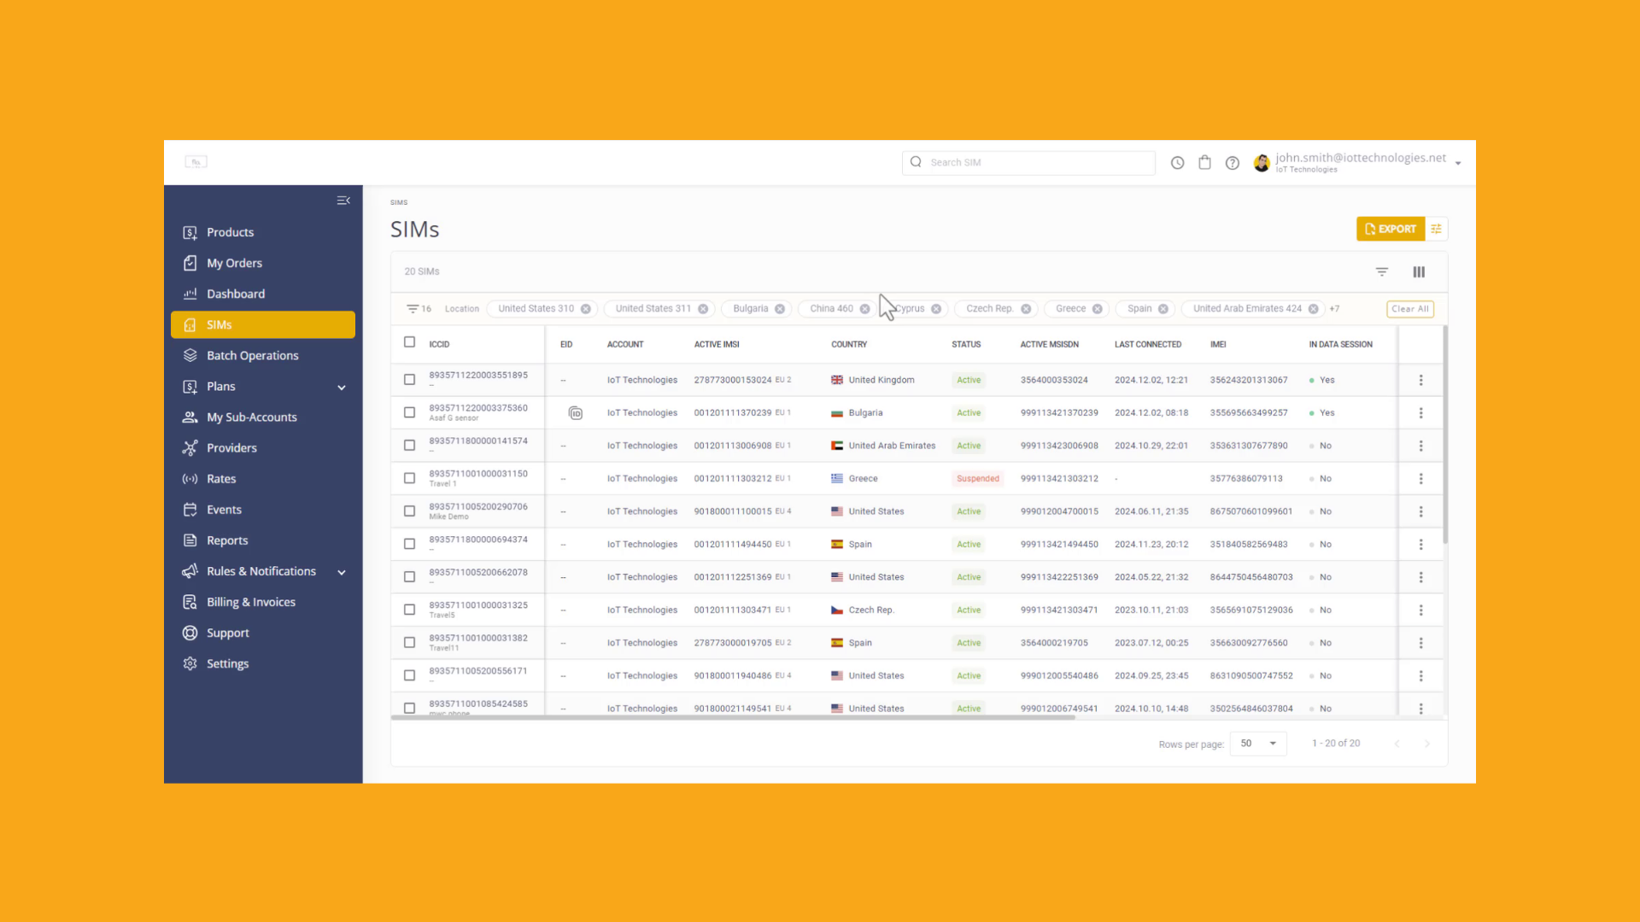
Notes:
Go to the top of the page and click the export properties icon. Select the columns you want to export, and then click the Export button. Your SIM data is exported to an Excel file and is located in your Downloads folder.

Slide 15

Notes:
Thank you for watching this video tutorial. For more information about the CMP system, make sure you visit our Knowledge-base that is accessible directly from the CMP Portal.

